Slide 1
Collective review Cardiac output monitoring
R3 ธีรวัฒน์ คุณาธินันท์
อาจารย์ ณรงค์ศักดิ์ เจษฎาภัทรกุล

Slide 2
Why monitor cardiac output ?

Slide 3
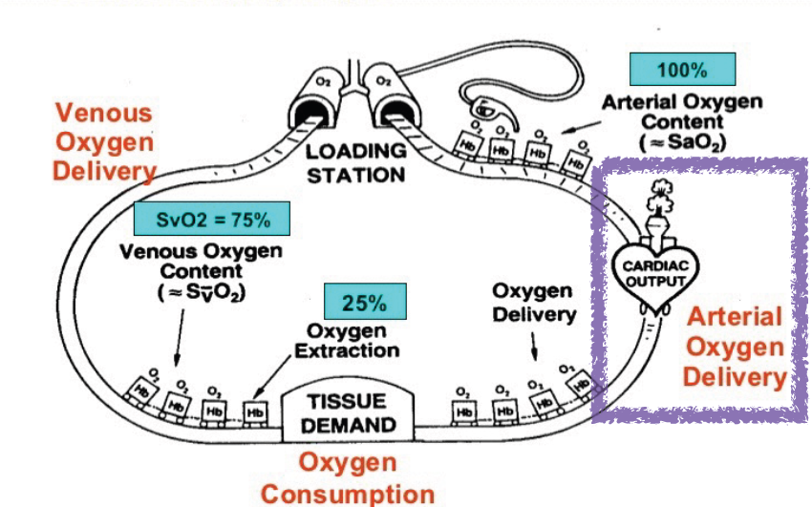

Slide 5
Fick's Principle
In 1870, Dr. Adolf Fick discovered a method of computing an animal’s CO based on the oxygen consumption and the difference in oxygen content between arterial and venous blood

Slide 6
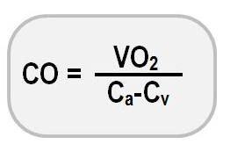
Fick's Principle
The principle:
" the total uptake of (or release of) a substance by the peripheral tissues is equal to the product of the blood flow to the peripheral tissues and the arterial-venous concentration difference (gradient) of the substance."

Slide 8
Cardiac output monitoring
Invasive cardiac output monitoring
Semi/minimally invasive cardiac output monitoring
Non-invasive cardiac output monitoring

Slide 9
Cardiac output monitoring
Invasive | Semi- invasive | Non -invasive
Continuous cardiac output monitoring (CCO) via PAC | FloTrac | Volume clamp methods
Intermittent thermodilution via PAC | Volume View | Bioreactance (NICOM)
 | PRAM | Bioimpedance
 | PiCCO
 | LidCO
 | Partial CO2 rebreathing technique
 | Transesophageal echocardiogram
 | Esophageal doppler monitor

Slide 10
Invasive cardiac output monitoring

Slide 11
Pulmonary artery catheter

Slide 12
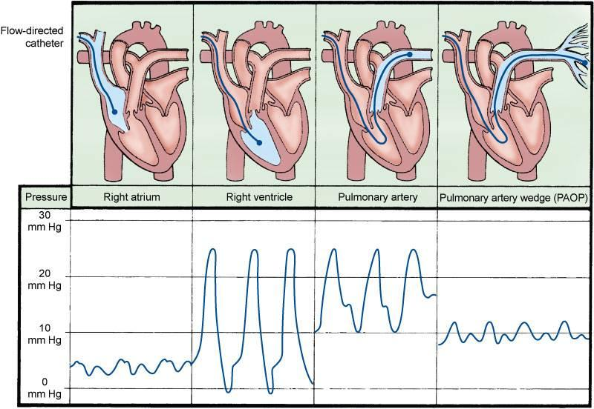
Pulmonary artery catheter

Slide 13
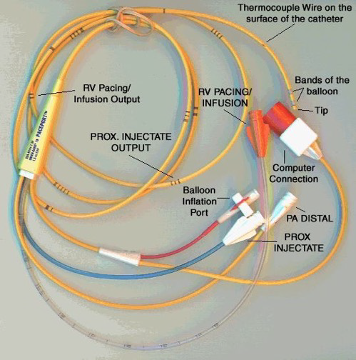
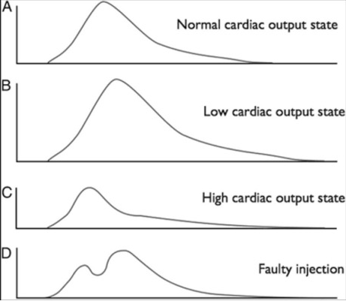
Pulmonary artery catheter

Slide 14
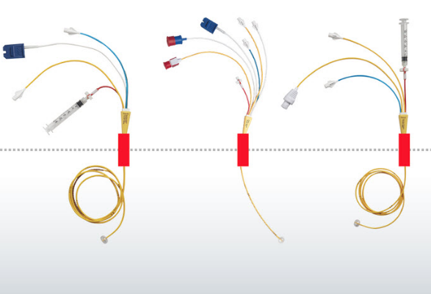
Pulmonary artery catheter
Advantages
The standard method for CO measurement
PAC provides, in addition, PA pressures, PAOP,mixed-venous oxygen saturation, RVEF and RVEDV

Slide 15
Pulmonary artery catheter
Limitations
Complications associated with placement and presence of a PAC

Slide 16
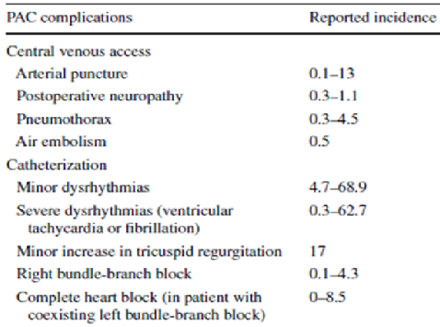

Slide 17
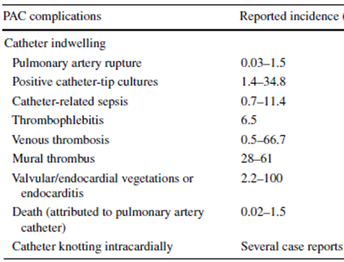

Slide 18
Semi-invasive cardiac output monitoring

Slide 19
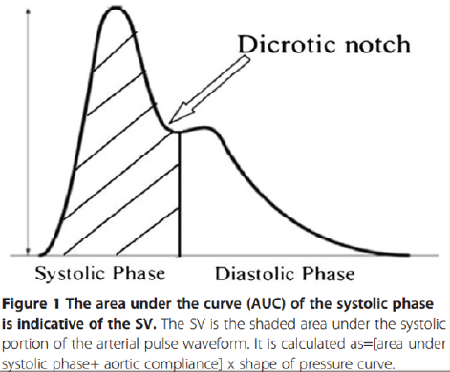
Pulse contour analysis
Stroke volume (SV)and systemic vascular resistance (SVR) calculate from arterial waveform

Slide 20
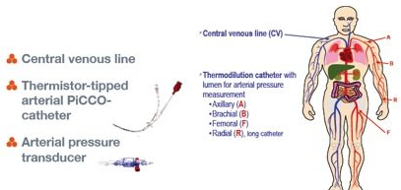
PiCCO
PiCCO monitor (Pulse Medical System, Munich, Germany)
PiCCO applies a special algorithm that combines real-time continuous monitoring through pulse contour analysis with intermittent transpulmonary thermodilution (TPTD) measurement

Slide 21
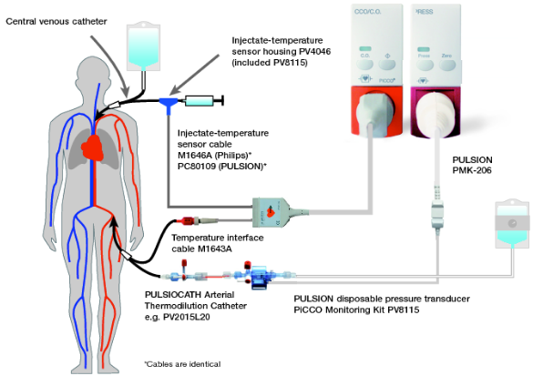

Slide 22
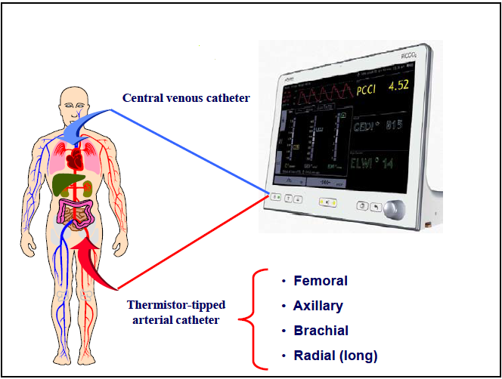

Slide 23
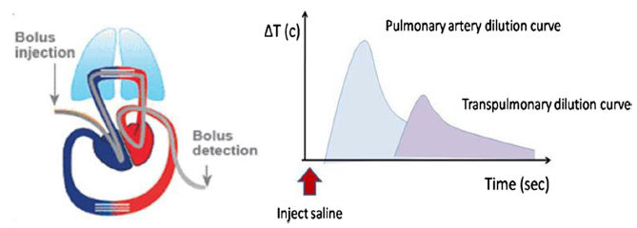
PiCCO

Slide 24
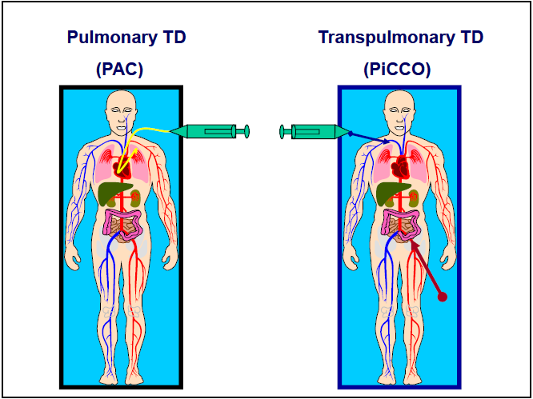

Slide 25
PiCCO
PiCCO arterial contour analysis uses the TPTD technique as an external calibration
The calibration interval is recommended to be every 8 h or whenever there is a clinically significant change in SVR

Slide 26
PiCCO
Advantages
less invasive
useful in the pediatric population when a PAC is too large to be inserted
independent of ventilator and respiratory cycles
measure global end-diastolic volume (GEDV) and intrathoracic blood volume (ITBV)

Slide 27
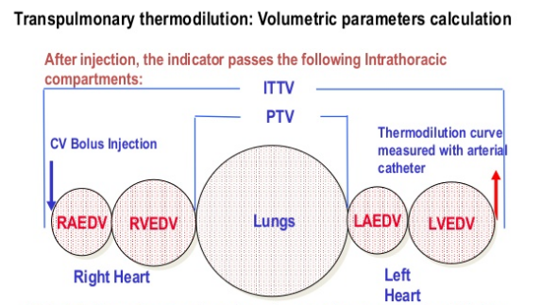
PiCCO

Slide 28
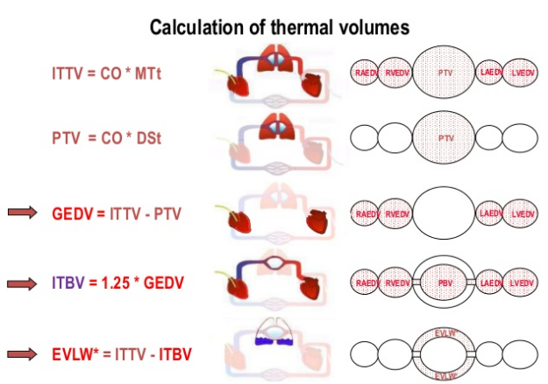
PiCCO

Slide 29
PiCCO

Slide 30
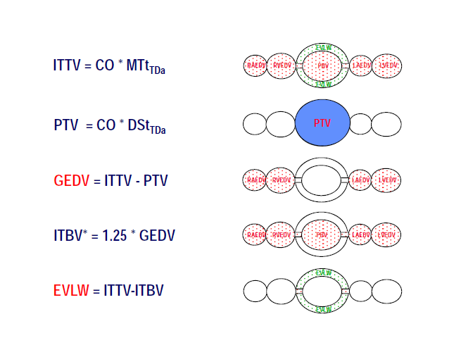

Slide 31
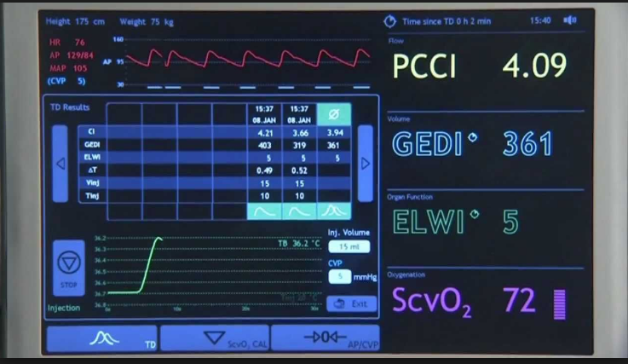

Slide 33
PiCCO
Limitations
regurgitant valve
intracardiac shunt
extracorporeal circulation

Slide 34
LiDCO
LiDCOplus system (LiDCO, Cambridge, UK)
based on running two proprietary algorithms
indicator dilution CO monitoring (LiDCO system)
continuous arterial waveform analysis (PulseCO system)
Consists of a lithium sensor attached to the arterial line
LiDCO system requires only an arterial line and a peripheral IV line

Slide 35
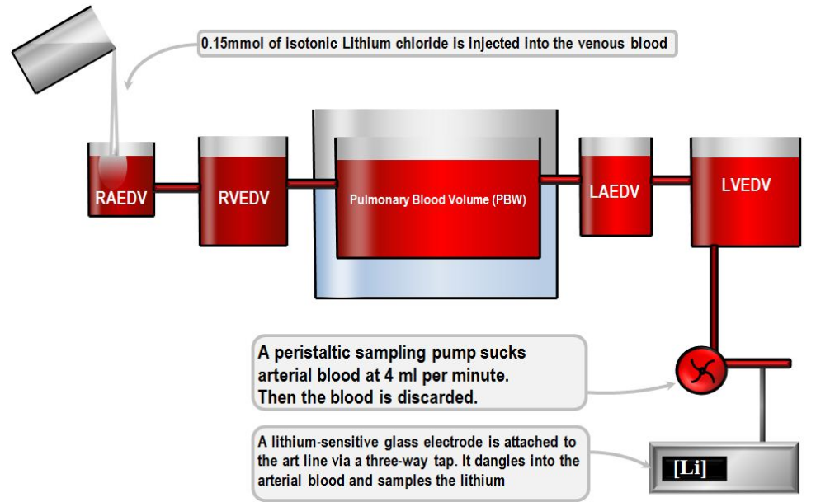

Slide 36
LiDCO
lithium is injected into the venous circulation, blood samples from the arterial line are drawn, and a lithium concentration time curve is plotted
area under the curve will determine CO
lithium indicator can be injected via either central or peripheral venous access

Slide 37
LiDCO
LiDCOplus system provides various parameters
CO
intrathoracic blood volume (ITBV)
MAP, SVR, SV
SVV and pulse pressure variation (PPV)
PulseCO system is recommended to be recalibrated every 8 h or with each major hemodynamic change

Slide 38
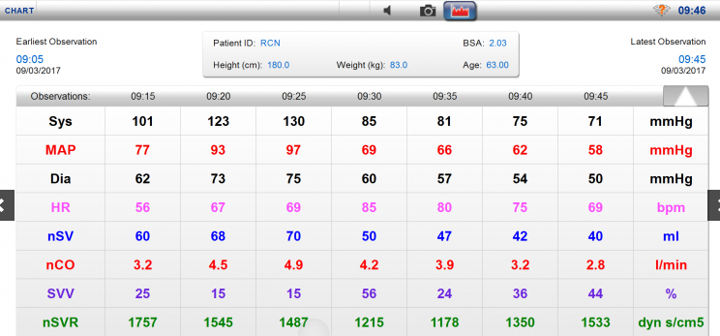
LiDCO

Slide 39
LiDCO
Advantages
less invasive than PAC and PiCCO
Limitations
aortic regurgitation
severe arrhythmia
severe peripheral vasoconstriction
patients who receive lithium therapy

Slide 40
LiDCO
Contraindications
conditions related to a patient’s extra lithium intake because this will lead to an overestimate of CO
patients who receive nondepolarizing muscle relaxant which will interfere with the lithium sensor
anatomic cardiac abnormalities
aortic valve regurgitation
intraaortic balloon pump (IABP)
poor quality of arterial signal

Slide 41
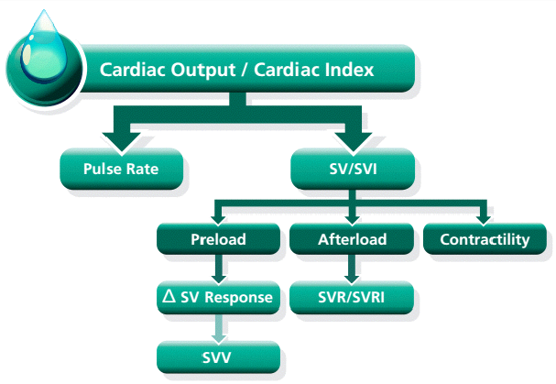

Slide 42
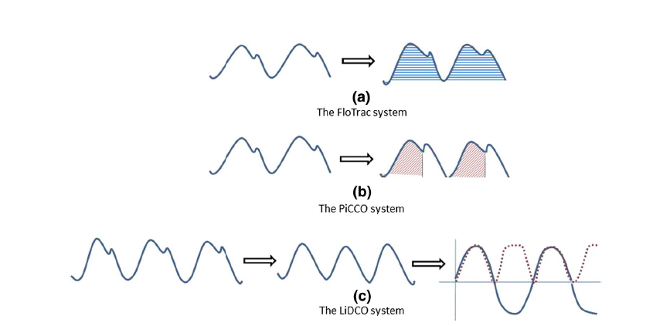

Slide 43
Volume View
The VolumeView system determines CO by continuous arterial pressure analysis on the femoral artery and external calibration using the TPTD technique
system consists of
specific thermistortipped arterial catheter (the VolumeView catheter) and the EV1000 monitoring platform
continuous central venous oxygen saturation (ScvO2) monitoring via the PreSep oximetry catheter

Slide 44
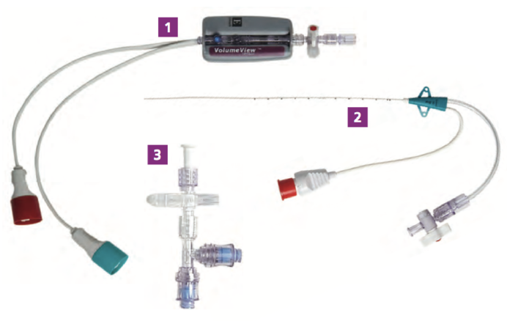
Volume View

Slide 45
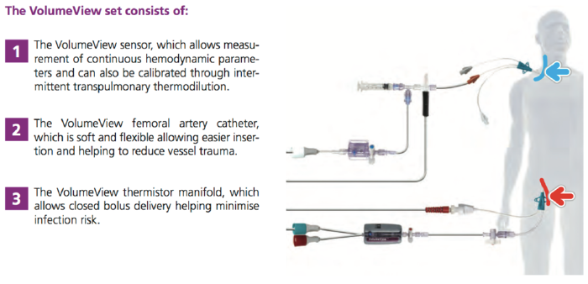

Slide 47
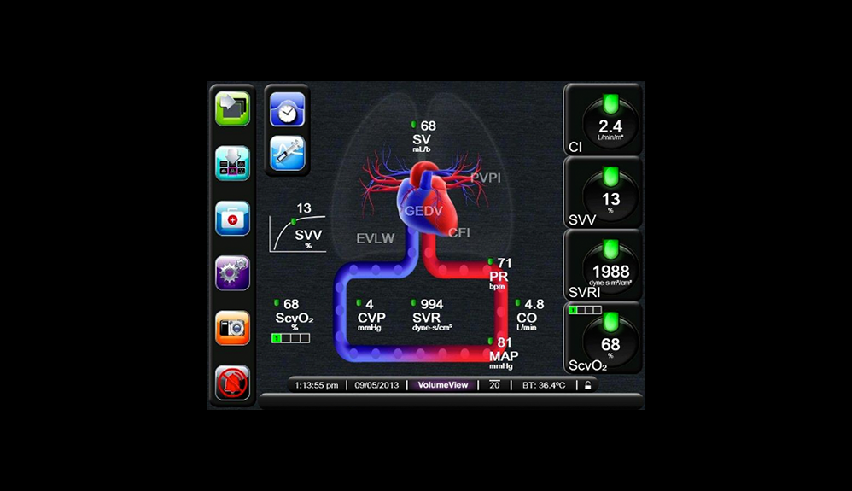

Slide 48
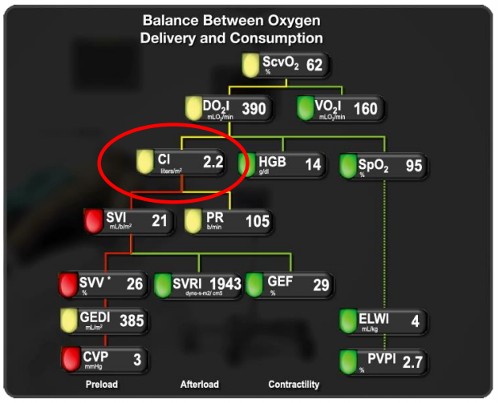

Slide 49
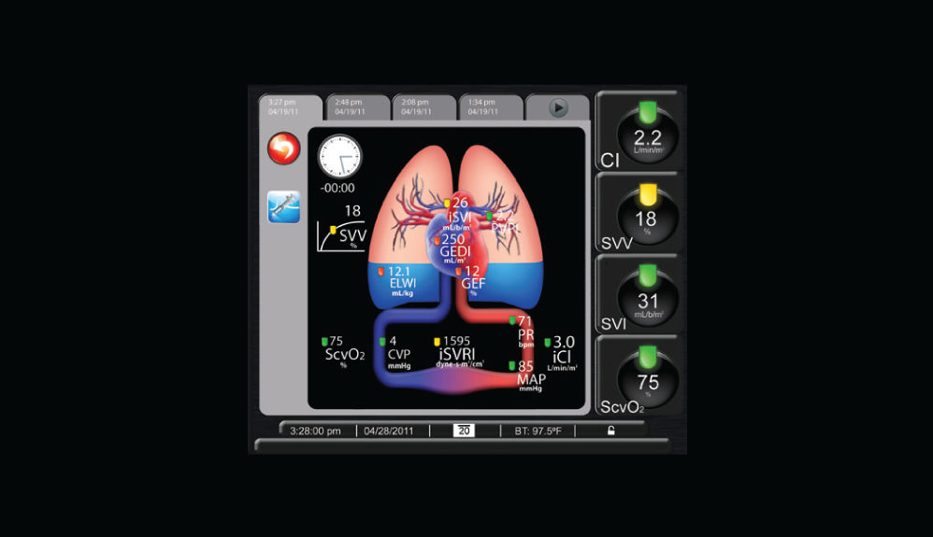

Slide 50
Volume view
Provide Informative volumetric parameters
Extravascular Lung Water (EVLW)
Pulmonary Vascular Permeability Index (PVPI)
Global End-Diastolic Volume (GEDV)
Global Ejection Fraction (GEF)
Cardiac function index (CFI)

Slide 51
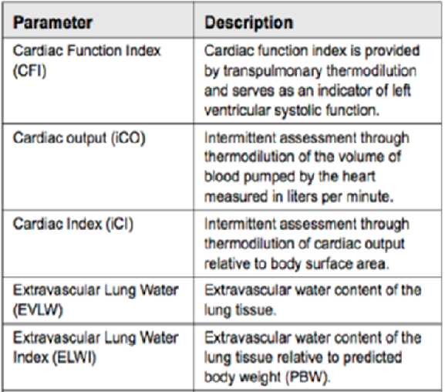

Slide 52
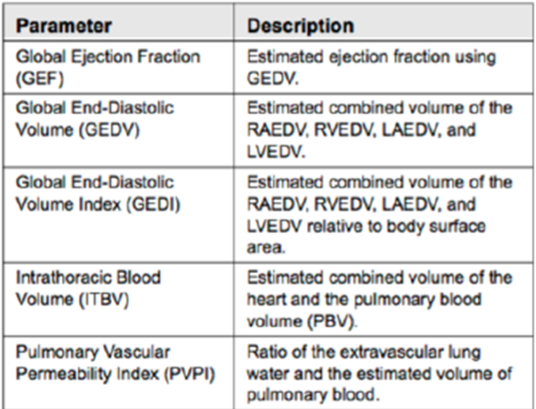

Slide 53
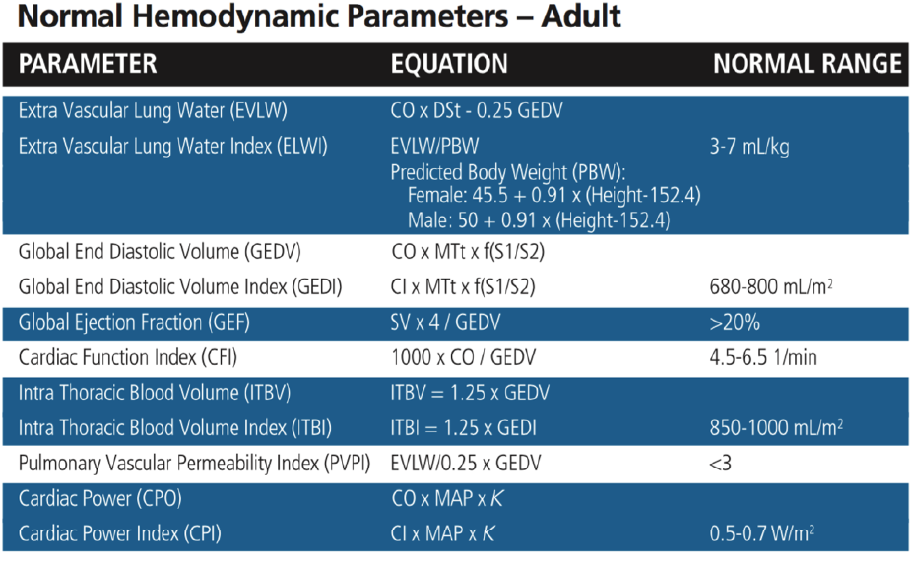

Slide 54
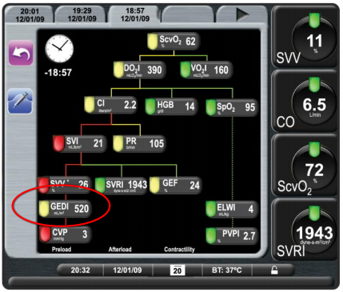
GEDV- Global End Diastolic Volume

Slide 55
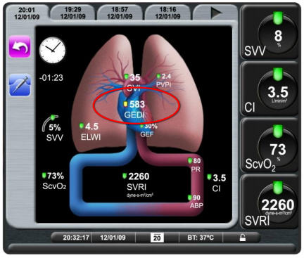
GEDV- Global End Diastolic Volume

Slide 56
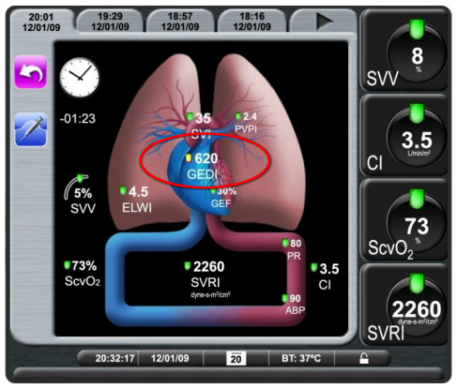
GEDV- Global End Diastolic Volume

Slide 57
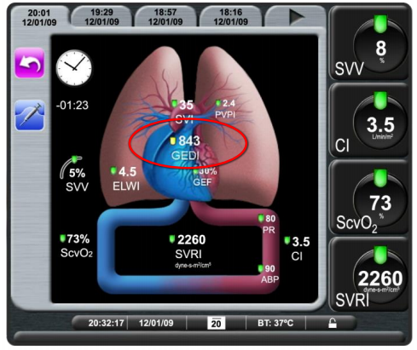
GEDV- Global End Diastolic Volume

Slide 58
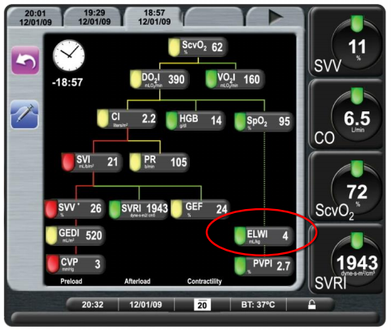
EVLW-Extra Vascular Lung Water

Slide 59
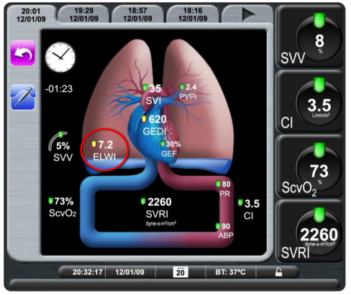
EVLW-Extra Vascular Lung Water

Slide 60
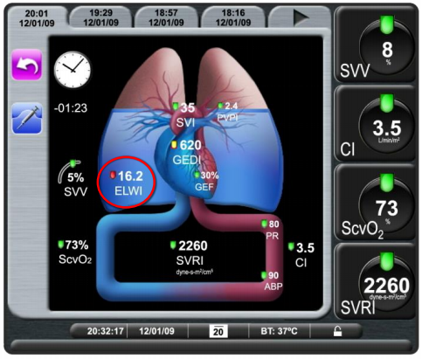
EVLW-Extra Vascular Lung Water

Slide 61
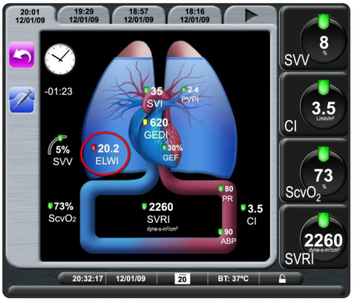
EVLW-Extra Vascular Lung Water

Slide 62
Limitations
Improper transducer position
Over/under-damped pressure lines
Arterial pressure inaccurate/not representative of aortic pressure
Excessive patient movement
Incorrect placement or position of the femoral artery catheter
Intra-aortic balloon pumps
Anatomical abnormalities (for example, cardiac shunts)

Slide 63
Limitations
Excessive variations/interference in blood temperature measurement such as
Post cardiopulmonary bypass surgery status
Centrally administered cooled/warmed solutions of blood products
Clot formation on the thermistor
External heat sources
Electrocautery or electrosurgical unit interference
Rapid changes in cardiac output

Slide 64
Applications in ICU
Determine possible causes of hemodynamic instability
Severe sepsis/Septic shock
ARDS/Acute lung injury
Pulmonary edema
Cardiogenic shock
Severe burn

Slide 65
Applications in ICU
Provide valuable hemodynamic information
Liver surgery
Cardiac surgery
Transplantation

Slide 66
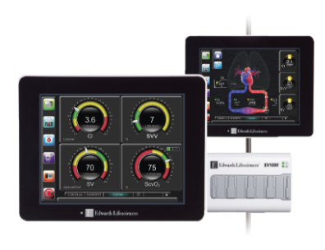
FloTrac
Derive SV from arterial waveform, after correcting for compliance and resistance of arterial system
Continuous computes stroke volume from arterial pressure signal

Slide 67
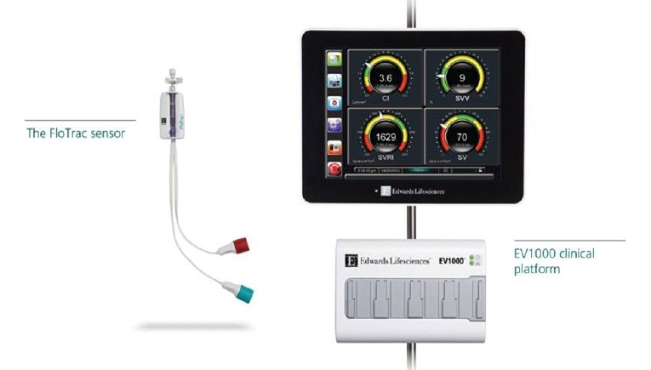

Slide 68
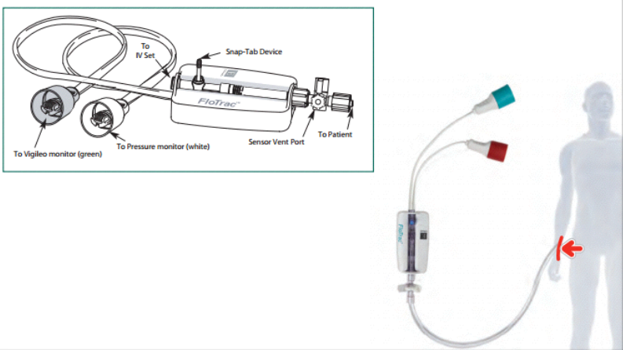

Slide 69
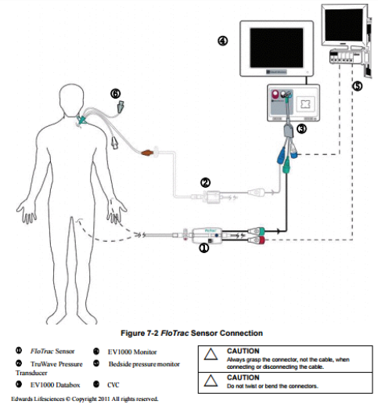

Slide 70
FloTrac
Connect to existing arterial catheter
Require no additional catheters, boluses or chemical indicators
Continuously monitors changes in the patient’s vascular tone (compliance and resistance)
Compatible with Vigileo monitor and the EV1000 clinical platform

Slide 71
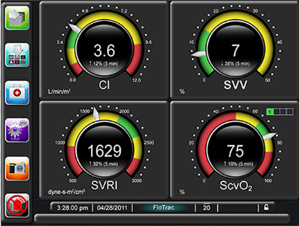
FloTrac
Advantages
less invasive
provides continuous
CO monitoring
Relatively easy to use

Slide 72
FloTrac
Limitations
Improper transducer posiotion
Over/under-damped pressure lines
Some conditions causing BP variations
Intra-aortic balloon pumps
Excessive patient movement
Electrocautery or electrosurgical unit interference

Slide 73
FloTrac
Limitations
Arterial pressure deemed inaccurate or not representative of aortic pressure, including
Extreme peripheral vasoconstriction
Compromised radial arterial pressure waveform
Hyperdynamic conditions
seen in post liver transplant
Aortic valve regurgitation - cause an over estimation of Stroke Volume / Cardiac Output

Slide 74
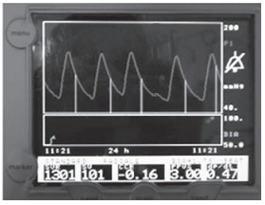
PRAM
PRAM (pressure‑recording analytical method)
arterial pressure-derived continuous CO measurement
PRAM needs only an arterial line as with FloTrac/Vigileo
Hemodynamic parameters including CO, SVV, PPV, and SVR

Slide 75
PRAM
principle that, in any given vessel, volume changes occur mainly because of radial expansion in response to pressure variations; simply put, the alterations of the systolic portion of the area under the curve reflect changes in SV

Slide 76
PRAM
Advantages
less invasive technique
continuous monitoring of CO
advanced hemodynamic parameters including SVV and PPV

Slide 77
PRAM
Limitations
technically related (over-damping or under-damping of arterial waveforms)
inappropriate signal acquisition (e.g., aortic valve regurgitation)
abnormality of the peripheral arteries (e.g., aortic dissection, atherosclerotic plaque)

Slide 78
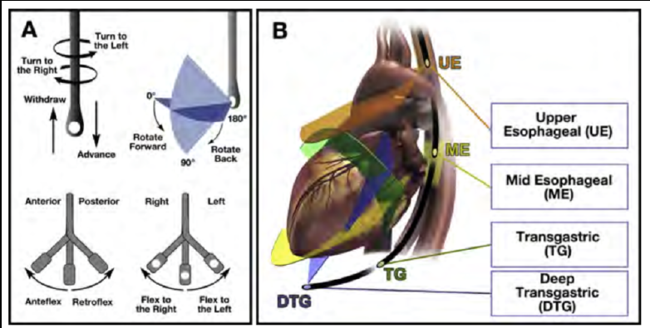
Transesophageal echocardiogram (TEE)

Slide 79
Indications
Intraoperative TEE
All open heart (i.e., valvular) and thoracic aortic surgical procedures
Use in some coronary artery bypass graft surgeries
Noncardiac surgery when patients have known or suspected cardiovascular pathology which may impact outcomes

Slide 80
Indications
Critically ill patients
Patients in whom diagnostic information is not obtainable by TTE and this information is expected to alter management

Slide 81
Indications
Evaluation of cardiac and aortic structure and function in situations where the findings will alter management
Guidance of transcatheter procedures

Slide 82
Transesophageal echocardiogram (TEE)
Advantages
detect anatomical abnormalities
volume status
myocardial contractility information and other functional assessment as well as hemodynamic parameters
real-time measurement of CO

Slide 83
Transesophageal echocardiogram (TEE)
Limitations
anesthetized patients
cannot be used in very small children
accuracy is also highly dependent upon the quality of echocardiographic images and the operator’s skill and experience

Slide 84
Absolute contraindication
Perforated viscus
Esophageal stricture
Esophageal tumor
Esophageal perforation, laceration
Esophageal diverticulum
Active upper GI bleed

Slide 85
Relative contraindication
History of radiation to neck and mediastinum
History of GI surgery
Recent upper GI bleed
Barrett’s esophagus
History of dysphagia
Symptomatic hiatal hernia

Slide 86
Relative contraindication
Restriction of neck mobility
Severe cervical arthritis
Atlantoaxial joint disease
Esophageal varices
Coagulopathy, thrombocytopenia
Active esophagitis
Active peptic ulcer disease

Slide 87
Esophageal doppler monitor
Doppler effect
Measure velocity of blood in Descending aorta in cm/s
Diameter of the aorta
Base on age, sex, weight,height

Slide 88
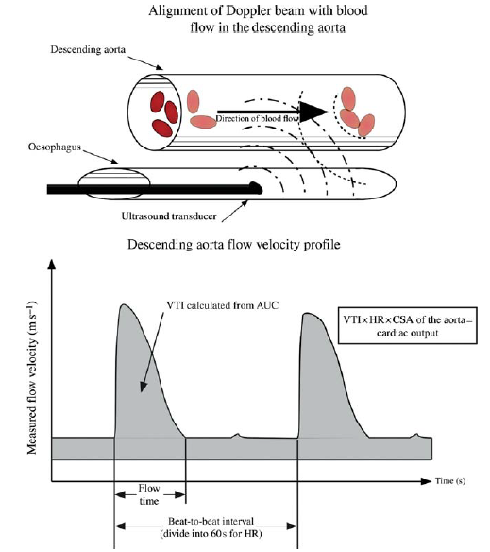
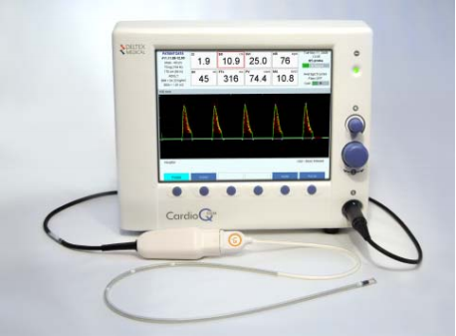
Esophageal doppler monitor

Slide 89
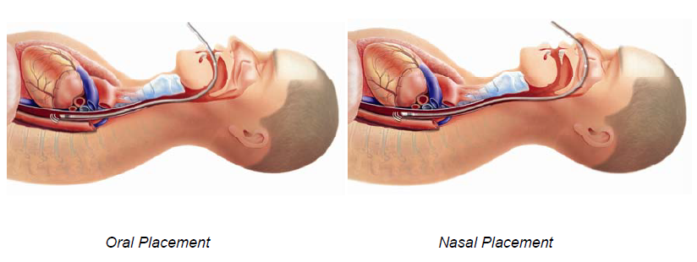
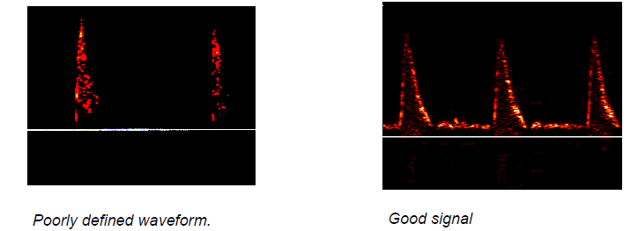

Slide 90
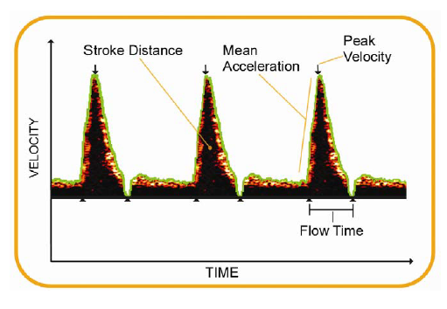

Slide 92
Esophageal doppler monitor
Parameter
CO ,CI
SV ,SVV
FTc

Slide 93
Esophageal doppler monitor

Slide 94
Esophageal doppler monitor

Slide 95
Limitations
Aortic pathology or compression or due to abnormal upper to lower body blood flow distribution
Aortic cross-sectional area - Not constant
Change in pulse pressure, vascular tone, aortic compliance, volume status, or catecholamine use

Slide 96
Limitations
Probe position - Critical to obtain accurate measurement for blood flow and aortic crosssectional measurement
Flow measuring
Only in descending aorta →70% total flow

Slide 97
Partial CO2 rebreathing technique
method applies Fick’s principle
by using expired carbon dioxide (CO2) concentration as an indicator
VCO2 - the difference between inspired and expired CO2 content
CvCO2 - estimated by using a partial rebreathing technique
CaCO2 is estimated from the PaCO2 and the end-tidal CO2

Slide 98
Partial CO2 rebreathing technique
Because the diffusion rate of carbon dioxide is 22 times more rapid than that oxygen, it is assumed that no difference in venous CO2 (CvCO2) will occur

Slide 102
Partial CO2 rebreathing technique
Advantages
minimal invasiveness
capability of continuous monitoring of CO
Limitations
intubated patients without severe gas-exchange abnormality
patients with PaCO2 above 30 mmHg
patient who cannot tolerate a brief rebreathing period

Slide 103
Non-invasive cardiac output monitoring

Slide 104
Thoracic electrical bioimpedance (TEB)
delivery of a low-amplitude high-frequency electrical current across the thorax
sensing electrodes measuring impedance are placed on the upper and lower thorax
Hemodynamic parameters are measured based on changes in the thoracic electrical conductivity to changes of thoracic aortic blood flow during the cardiac cycle

Slide 105
Thoracic electrical bioimpedance (TEB)

Slide 106
Thoracic electrical bioimpedance (TEB)
TEB involves delivery of a low-amplitude high-frequency electrical current across the thorax
changes in the thoracic electrical conductivity to changes of thoracic aortic blood flow during the cardiac cycle
measuring the impedance change generated by the pulsatile flow and the time intervals between the changes, SV can be calculated

Slide 107
Thoracic electrical bioimpedance (TEB)
Advantage
TEB is a completely noninvasive CO monitoring method
Limitations
arrhythmia
fluid in the thoracic component
noise from mechanical ventilation or surgical electrocautery

Slide 108
Electrical bioreactance cardiography

Slide 109
Electrical bioreactance cardiography(EB)
EB analysis is based on changes in frequency of electrical resistivity across the thorax
EB signal is less susceptible to interference from chest wall movement, lung edema, and pleural effusion. EB technology is commercially available as the NICOM system in the U.S.

Slide 110
Electrical bioreactance cardiography
Advantages
Noninvasive
continuous monitoring with more variety in clinical applications (e.g., from small children to adults) and is very safe for clinical use

Slide 111
Electrical bioreactance cardiography
Limitations
signal interference was reported by electrocautery causing transiently impaired signals
during episodes of low flow, NICOM signals may lose their accuracy

Slide 112
The ccNexfin system
completely noninvasive continuous CO monitoring system
ccNexfin system provides various hemodynamic parameters including continuous BP, SV, CO, SVV, and SVR

Slide 113
The ccNexfin system

Slide 114
The ccNexfin system
Essence of the volume clamp method involves
Clamping artery to a constant volume by dynamically providing equal pressure on either side of arterial wall
Volume - Measure by a photoplethysmograph built into cuff
Counter pressure - apply by an inflatable bladder inside the cuff and adjust 1000 times per second to keep arterial volume constant

Slide 115
The ccNexfin system
Advantages
noninvasive CO monitoring
Limitations
requires the finger cuff to be inflated continuously
maximum of 8 h per finger
severe peripheral vasoconstriction
edematous fingers
regurgitant aortic valve
aneurysm in the proximal aorta

Slide 116
Device | Invasiveness | Equipment required | Limitations | Information
PAC- TD Continuous PAC_TD | ++++ | - Central venous access - Thermodilution capable PAC | PAC related complication | PAP,PCWP, SvO2
Pulse contour analysis PiCCO +TPTD | +++ | Thermistor-tipped arterial line in a central vessel CVC | -Requires intermittent recalibration and a central arterial catheter -Less accurate with significant aortic regurgitation, arrhythmia, or intra-aortic balloon pump | EVLW, GEDV, ITBV, SVV, PVV, ScvO2
Pulse contour analysis LiDCO +TPTD | +++ | Arterial line +/-CVC | -Requires intermittent recalibration -Intracardiac and extracardiac Shunts -Require good quality of arterial waveform -Calibration affected by muscle relaxant and lithium therapy | ITBV, SVV, PVV

Slide 117
Device | Invasiveness | Equipment required | Limitations | Information
Volume View | +++ | Require A-line and CVP | --Require good quality of arterial waveform | EVLW, PVPI, GEDV, ITBV, GEF, SVV, PPV, ScvO2
floTrac/ Vigileo | ++ | A-line | - No external calibration -Arterial signal quality -Rapid changes in vascular motor tone -Not indicated for IABP - Inaccuracy in hemodynamic instability | CO,SVV, PPV, MAP
PRAM | ++ | A-line | - Arterial signal quality -Rapid changes in vascular motor tone - Inaccuracy in such an abnormal arteries | SVV, PPV, MAP

Slide 118
Device | Invasiveness | Equipment required | Limitations | Information
TEE | + | TEE probe | Cost Operator dependent | EF, LVEDA, diameter of IVC/SVC
ED | + | ED probe | - Poorly tolerated unless tracheal tube present | CO,SV,PV
Partial CO2 rebreathing | + | NICO Rebreathing circuit ETT A-line | - Requires tracheal intubation and stable tidal volumes during measurements - accuracy limits in patient with abnormal V/Q mismatch -Valid only with CO2 >30 mmHg - patient who cannot tolerate a brief rebreathing period | CO

Slide 119
Device | Invasiveness | Equipment required | Limitations | Information
volume clamp method | - | ClearSight system ccNexfin | -measurement is restricted to 8 h - strong vasoconstriction, Raynaud disease or very edematous fingers - erroneous may occur in patient with aortic valve insufficiency or proximal aneurysm | MAP, SVV, PPV
Bioimpedance | - | Biomed electrode | -movement artifacts, e.g., noise from mechanical ventilator, electrocautery -thoracic fluid overload -arrhythmia - need to be intubated Signal stability fails after 24 h | CO
Bioreactance | - | NICOM electrode | -limit in condition of low flow period -signal artifact, e.g., electrocautery | CO

Slide 120
References
Minimally invasive or noninvasive cardiac output measurement:an update , Japanese Society of Anesthesiologists 2016, 30:461–480
Annals of Cardiac Anaesthesia , Vol. 11:1 ,Jan-June-2008
Minimally invasive cardiac output monitors,Continuing Education in Anaesthesia, Critical Care & Pain ,Volume 12 Number 1 2012
Newer methods of cardiac output monitoring, World Journal of Cardiology 2014 September 26; 6(9): 1022-1029
Invasive and non-invasive methods for cardiac output measurement, International Journal of Caring Sciences, 1(3):112–117

